Slide 1

Reminders
HW2 is due tonight before 11:59pm Eastern time.
HW3 has been released.
Register to vote: https://vote.gov Online registration and mail-in request deadline: Monday, October 19, 2020
Be a poll worker: https://www.votespa.com/Resources/Pages/Be-a-Poll-Worker.aspx

Slide 2

A* search is Optimal
AIMA 3.5
Notes:
.

Slide 3


Key: Admissibility
Inadmissible (pessimistic) heuristics break optimality by pushing good plans too far back on the frontier, which means they may never get expanded.
Admissible (optimistic) heuristics slow down bad plans but never outweigh true costs. That means that the true best plan will always be expanded.
Slide credit: Dan Klein and Pieter Abbeel
http://ai.berkeley.edu
Notes:
.

Slide 4



Admissible Heuristics
A heuristic h is admissible (optimistic) if:
where is the true cost to a nearest goal
Is Manhattan Distance admissible?
Coming up with admissible heuristics is most of what’s involved in using A* in practice.
Notes:
.

Slide 5


Optimality of A* Tree Search
Assume:
A is an optimal goal node
B is a suboptimal goal node
h is admissible
Claim:
A will exit the frontier before B
…
Slide credit: Dan Klein and Pieter Abbeel
http://ai.berkeley.edu
Notes:
.

Slide 6




Optimality of A* Tree Search
…
Proof:
Imagine B is on the frontier
Some ancestor n of A is on the frontier, too (maybe A!)
Claim: n will be expanded before B
f(n) is less or equal to f(A)
Definition of f-cost
Admissibility of h
h = 0 at a goal
Slide credit: Dan Klein and Pieter Abbeel
http://ai.berkeley.edu
Notes:
g = path cost, h = admissible heuristic of remaining distance to goal

Slide 7


Optimality of A* Tree Search
…
Proof:
Imagine B is on the frontier
Some ancestor n of A is on the frontier, too (maybe A!)
Claim: n will be expanded before B
f(n) is less or equal to f(A)
f(A) is less than f(B)
B is suboptimal
h = 0 at a goal
Slide credit: Dan Klein and Pieter Abbeel
http://ai.berkeley.edu
Notes:
g = path cost, h = admissible heuristic of remaining distance to goal

Slide 8

Optimality of A* Tree Search
Proof:
Imagine B is on the frontier
Some ancestor n of A is on the frontier, too (maybe A!)
Claim: n will be expanded before B
f(n) is less or equal to f(A)
f(A) is less than f(B)
n expands before B
All ancestors of A expand before B
A expands before B
A* search is optimal
…
Slide credit: Dan Klein and Pieter Abbeel
http://ai.berkeley.edu

Slide 9
Properties of A*
Slide credit: Dan Klein and Pieter Abbeel
http://ai.berkeley.edu
Notes:
.

Slide 10
Properties of A*
Uniform-Cost
A*
b
b
…
…
Slide credit: Dan Klein and Pieter Abbeel
http://ai.berkeley.edu
Notes:
.

Slide 11
UCS vs A* Contours
Uniform-cost expands equally in all “directions”
A* expands mainly toward the goal, but does hedge its bets to ensure optimality
Start
Goal
Start
Goal
Slide credit: Dan Klein and Pieter Abbeel
http://ai.berkeley.edu
Notes:
.

Slide 12
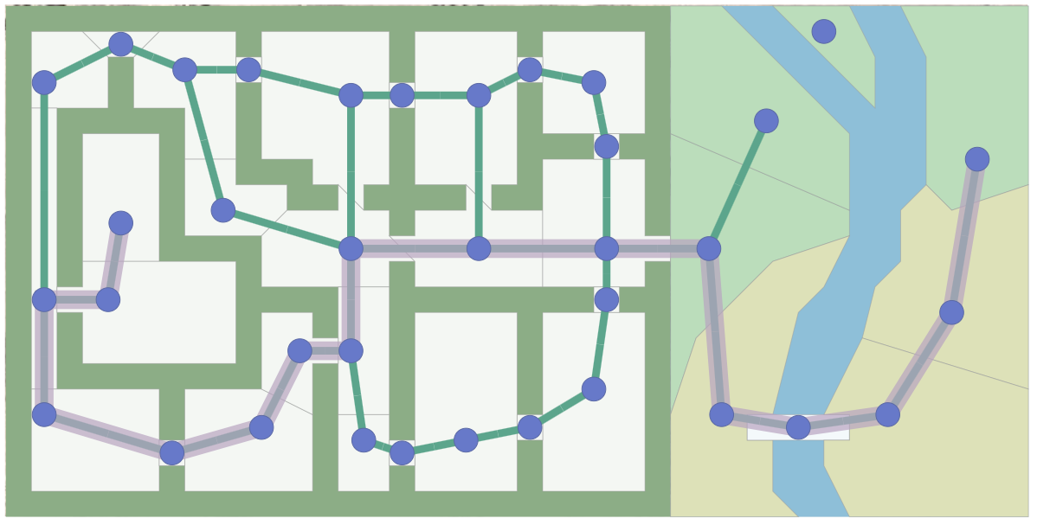
A* Applications
Pathing / routing problems (A* is in your GPS!)
Video games
Robot motion planning
Resource planning problems
…
Notes:
.

Slide 13
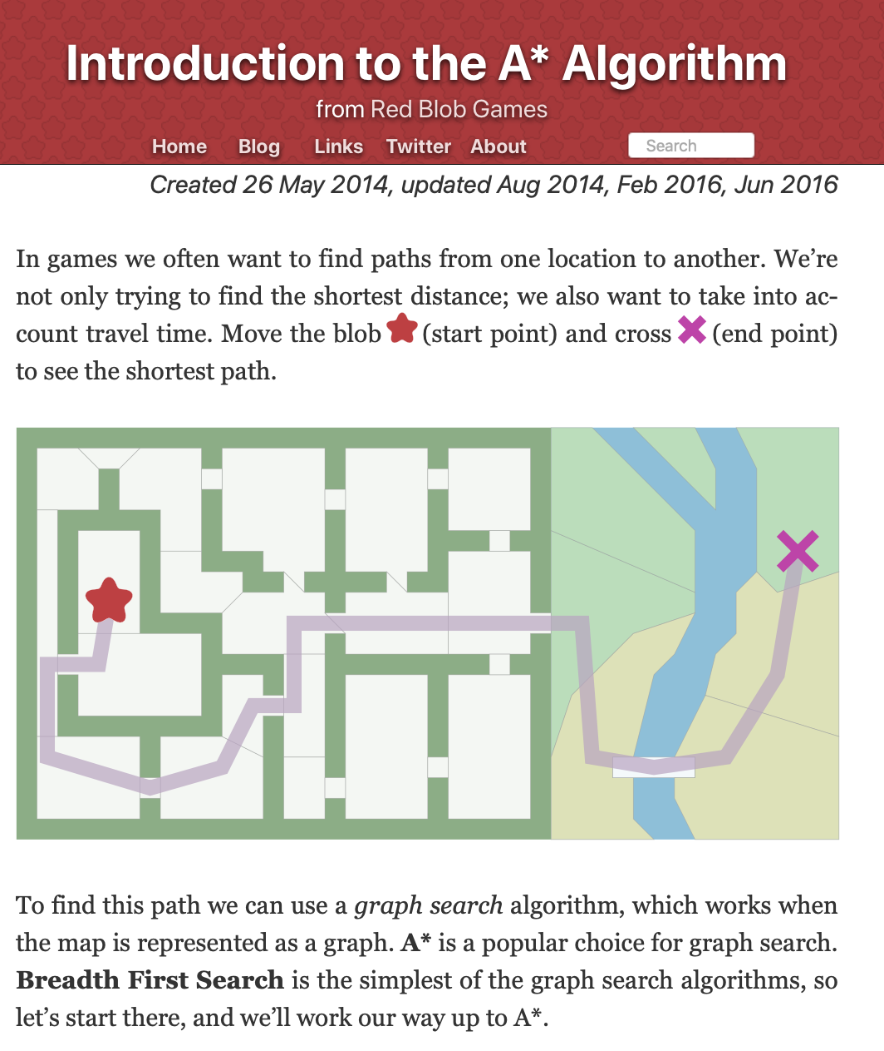
Supplemental Reading
I recommend this A* tutorial by Amit Patel of Red Blob Games
https://www.redblobgames.com/pathfinding/a-star/introduction.html

Slide 14
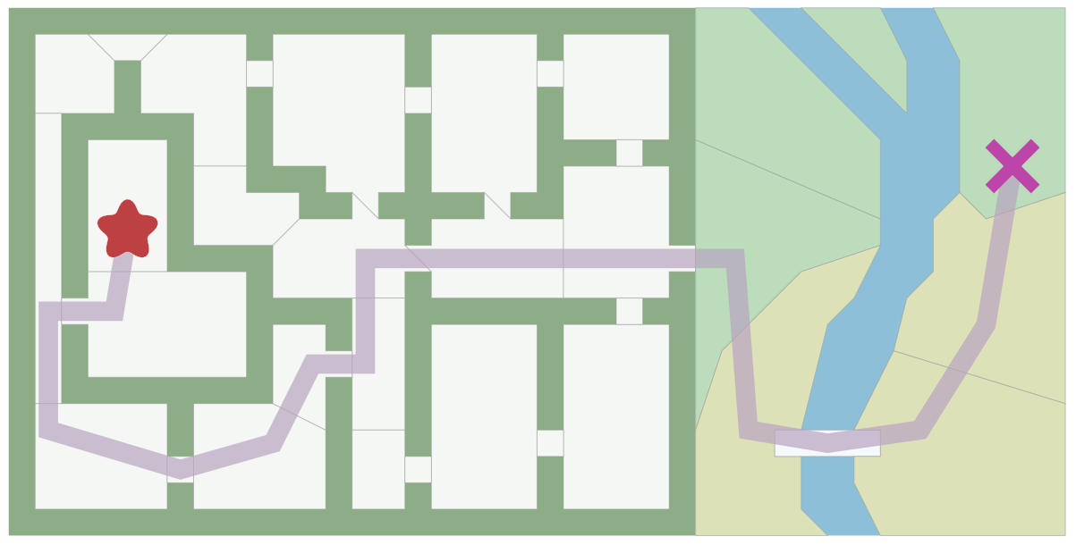
Pathfinding in Games
https://www.redblobgames.com/pathfinding/a-star/introduction.html

Slide 15
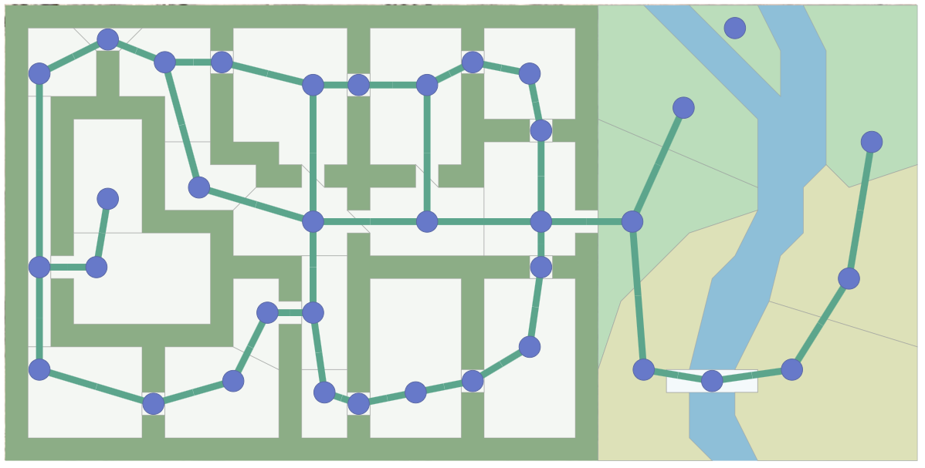
Pathfinding in Games
https://www.redblobgames.com/pathfinding/a-star/introduction.html

Slide 16
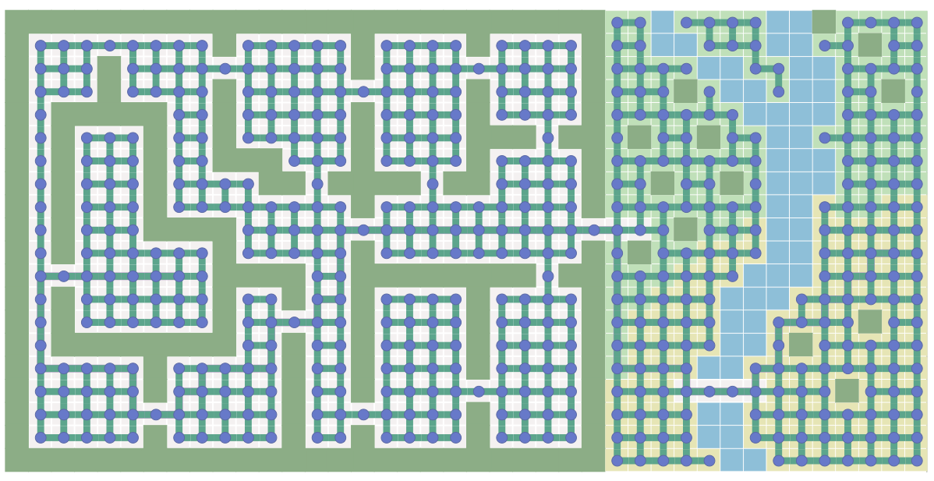
Pathfinding in Games
https://www.redblobgames.com/pathfinding/a-star/introduction.html

Slide 17
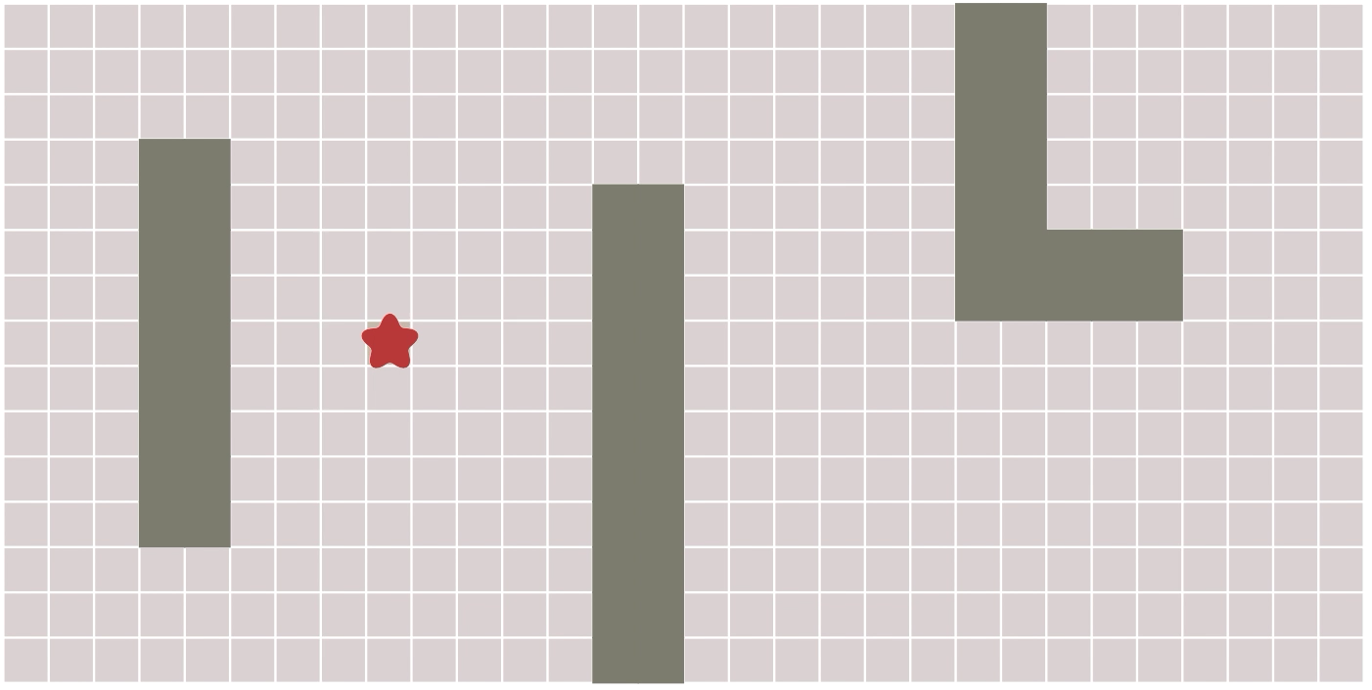
Breadth First Search
https://www.redblobgames.com/pathfinding/a-star/introduction.html

Slide 18
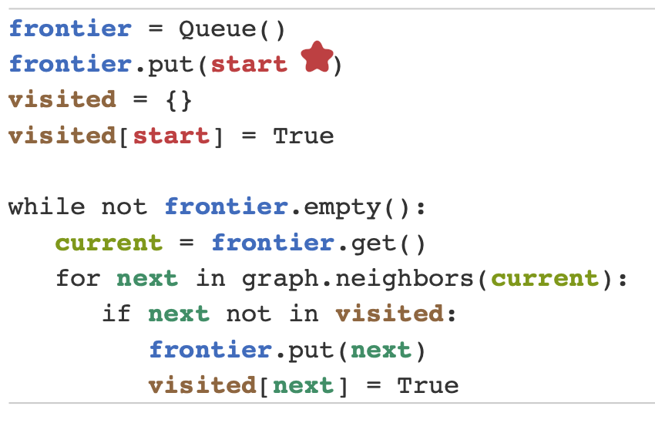
BFS in 10 lines of Python
https://www.redblobgames.com/pathfinding/a-star/introduction.html

Slide 19
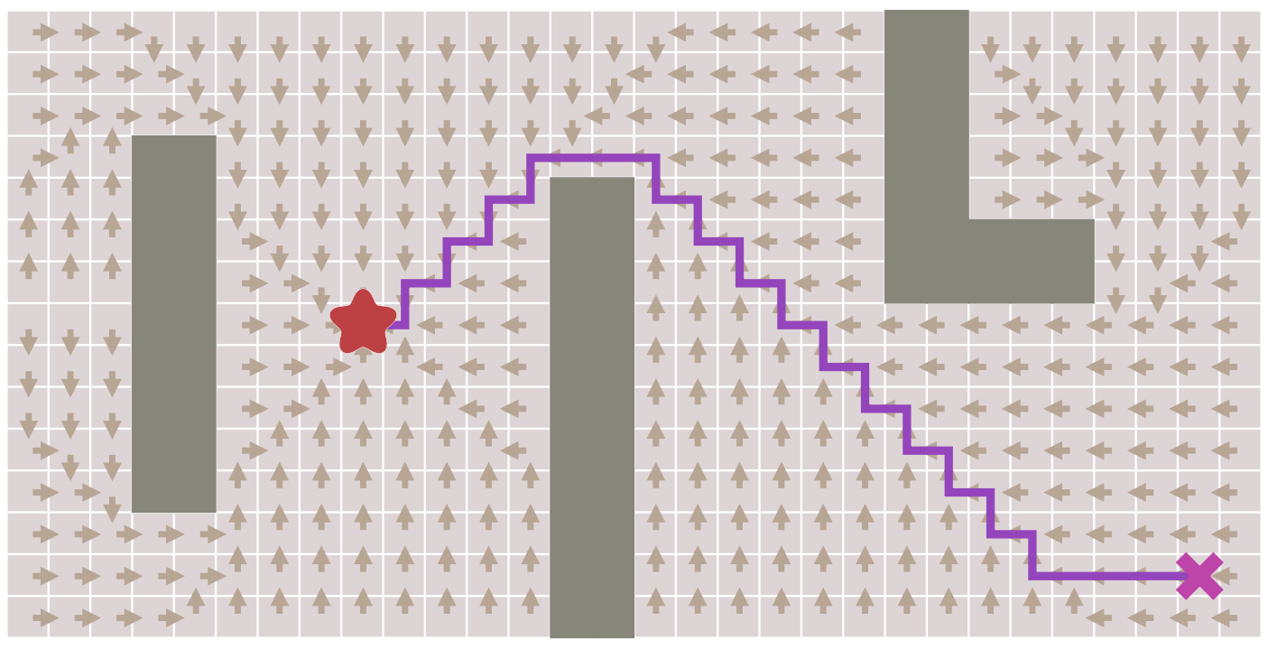
Finding the shortest path
https://www.redblobgames.com/pathfinding/a-star/introduction.html

Slide 20
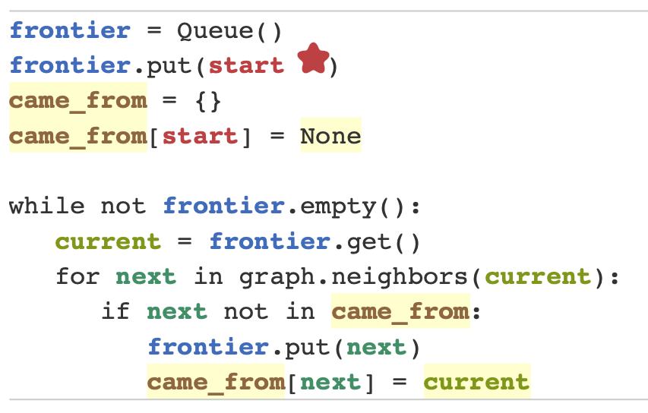
Finding the shortest path
https://www.redblobgames.com/pathfinding/a-star/introduction.html

Slide 21
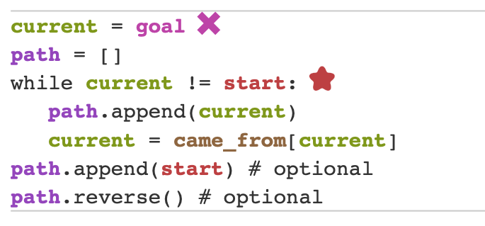
Finding the shortest path

